Slide 1
Object Oriented Programming
rachmadi
Rahmadi Wijaya
D3 Teknik Informatika
Fakultas Ilmu Terapan
Telkom University
2016

Slide 2
What is Java Technology?
1. A programming language
As a programming language, Java can create all kinds of applications that you could create using any conventional programming language

Slide 3
2. A development environment
As a development environment, Java technology provides you with a large suite of tools: a compiler, an interpreter, a documentation generator, a class file packaging tool, and so on.

Slide 4
3. An application environment
There are two main deployment environments: First, the JRE supplied by the Java 2 Software Development Kit (SDK) contains the complete set of class files for all the Java technology packages, which includes basic language classes, GUI component classes, and so on.
The other main deployment environment is on your web browser

Slide 5
Phases of a Java Program

Slide 6
Summary of Phases of a Java Program

Slide 7
My First Java Program
public class Hello
{
/**
* My first java program
*/
public static void main(String[] args) {
//prints the string "Hello world" on screen
System.out.println("Hello world!");
}
}

Slide 8
1. Using a Text Editor and Console
For this example, we will be using a text editor to edit the Java source code
You will also need to open the Terminal window to compile and execute your Java programs

Slide 9
TUGAS
Singkatan dari IDE dan sebutkan apa saja ?

Slide 10
2. Using NetBeans
Now that we've tried doing our programs the complicated way.
Let's now see how to do all the processes we've described in the previous sections by using just one application

Slide 11
Java Statements and blocks
A statement is one or more lines of code terminated by a semicolon. An example of a single statement is,
System.out.println(“Hello world”);
A block is one or more statements bounded by an opening and closing curly braces that groups the statements as one unit.
Block statements can be nested indefinitely. Any amount of white space is allowed. An example of a block is,
public static void main( String[] args ){
System.out.println("Hello");
System.out.println("world");
}

Slide 12
Variables
A variable is an item of data used to store state of objects.
A variable has a data type and a name.
The data type indicates the type of value that the variable can hold
Declaring and Initializing Variables
To declare a variable is as follows,
<data type> <name> [=initial value];
Note :
Values enclosed in <> are required values, while
those values enclosed in [] are optional

Slide 13
Examples :
public class Coba_tipe {
public static void main(String[] args) {
int nilai;
char indexnilai;
nilai = 100;
indexnilai='A';
System.out.println(nilai);
System.out.println(indexnilai);
}
}

Slide 14
Outputting Variable Data
In order to output the value of a certain variable, we can use the following commands,
System.out.println()
System.out.print()
Here's a sample program,
public class OutputVariable
{
public static void main( String[] args ){
int value = 10;
char x;
x = ‘A’;
System.out.println( value );
System.out.println( “The value of x=“ + x );
}
}

Slide 15
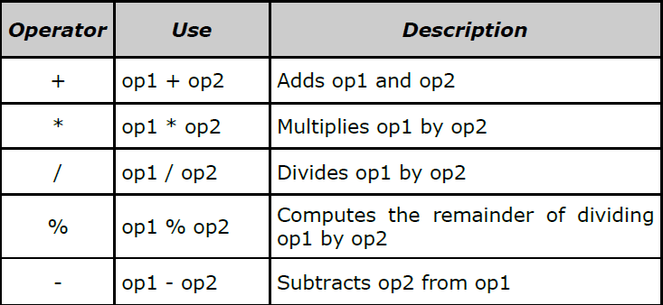
Operators
In Java, there are different types of operators. There are arithmetic operators, relational operators, logical operators and conditional operators.
1. Arithmetic operators

Slide 16
public class ArithmaticDemo {
public static void main(String[] args) {
int i = 37; int j = 42;
double x = 27.475; double y = 7.22;
System.out.println("Variable values...");
System.out.println(" i = " + i);
System.out.println(" j = " + j);
System.out.println(" x = " + x);
System.out.println(" y = " + y); //adding numbers
System.out.println("Adding...");
System.out.println(" i + j = " + (i + j));
System.out.println(" x + y = " + (x + y));
System.out.println("Subtracting...");
System.out.println(" i - j = " + (i - j));
System.out.println(" x - y = " + (x - y));
System.out.println("Multiplying...");
System.out.println(" i * j = " + (i * j));
System.out.println(" x * y = " + (x * y));

Slide 17
System.out.println("Dividing...");
System.out.println(" i / j = " + (i / j));
System.out.println(" x / y = " + (x / y));
System.out.println("Computing the remainder...");
System.out.println(" i % j = " + (i % j));
System.out.println(" x % y = " + (x % y));
System.out.println("Mixing types...");
System.out.println(" j + y = " + (j + y));
System.out.println(" i * x = " + (i * x));
}
}

Slide 18
2. Increment and Decrement operators
Aside from the basic arithmetic operators, Java also includes a unary increment operator (++) and unary decrement operator (--).
Increment and decrement operators increase and decrease a value stored in a number variable by 1
For example, the expression,
count = count + 1;
is equivalent to,
count++;

Slide 19
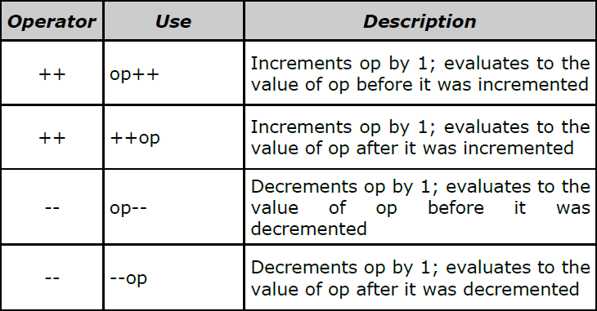

Slide 20
The increment and decrement operators can be placed before or after an operand.
When used before an operand, it causes the variable to be incremented or decremented by 1, and then the new value is used in the expression in which it appears.
For example,
int i = 10,
int j = 3;
int k = 0;
k = ++j + i; //will result to k = 4+10 = 14

Slide 21
When the increment and decrement operators are placed after the operand, the old value of the variable will be used in the expression where it appears.
For example,
int i = 10,
int j = 3;
int k = 0;
k = j++ + i; //will result to k = 3+10 = 13

Slide 22
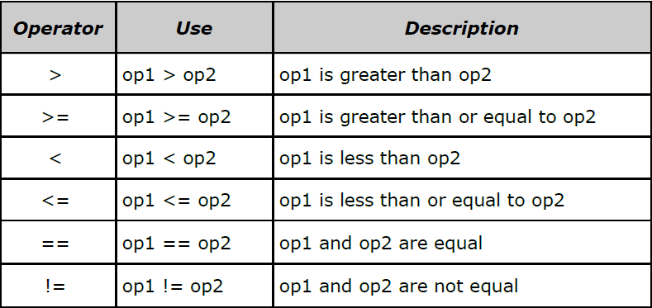
3. Relational operators
Relational operators compare two values and determines the relationship between those values. The output of evaluation are the boolean values true or false

Slide 23
public class RelationalDemo {
public static void main(String[] args) {
int i = 37;
int j = 42;
int k = 42;
System.out.println("Variable values...");
System.out.println(" i = " + i);
System.out.println(" j = " + j);
System.out.println(" k = " + k);
System.out.println("Greater than...");
System.out.println(" i > j = " + (i > j)); //false
System.out.println(" j > i = " + (j > i)); //true
System.out.println(" k > j = " + (k > j)); //false
System.out.println("Greater than or equal to...");
System.out.println(" i >= j = " + (i >= j)); //false
System.out.println(" j >= i = " + (j >= i)); //true
System.out.println(" k >= j = " + (k >= j)); //true

Slide 24
System.out.println("Less than...");
System.out.println(" i < j = " + (i < j)); //true
System.out.println(" j < i = " + (j < i)); //false
System.out.println(" k < j = " + (k < j)); //false
System.out.println("Less than or equal to...");
System.out.println(" i <= j = " + (i <= j)); //true
System.out.println(" j <= i = " + (j <= i)); //false
System.out.println(" k <= j = " + (k <= j)); //true
System.out.println("Equal to...");
System.out.println(" i == j = " + (i == j)); //false
System.out.println(" k == j = " + (k == j)); //true
System.out.println("Not equal to...");
System.out.println(" i != j = " + (i != j)); //true
System.out.println(" k != j = " + (k != j)); //false
}
}

Slide 25
4. Logical operators
Logical operators have one or two boolean operands that yield a boolean result.
There are six logical operators: && (logical AND), & (boolean logical AND), || (logical OR), | (boolean logical inclusive OR), ^ (boolean logical exclusive OR), and ! (logical NOT).
The basic expression for a logical operation is,
x1 op x2
where x1, x2 can be boolean expressions, variables or constants, and op is either &&, &, ||, | or ^ operator.
The truth tables that will be shown next, summarize the result of each operation for all possible combinations of x1 and x2.
Distributed

Slide 26
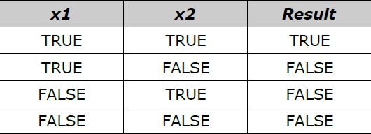
&& (logical AND) and & (boolean logical AND)
&& will evaluate the expression exp1, and immediately return a false value is exp1 is false.
If exp1 is false, the operator never evaluates exp2 because the result of the operator will be false regardless of the value of exp2.
In contrast, the & operator always evaluates both exp1 and exp2 before returning an answer

Slide 27
public class TestAND {
public static void main( String[] args ){
int i = 0;
int j = 10;
boolean test= false;
test = (i > 10) && (j++ > 9);
System.out.println(i);
System.out.println(j);
System.out.println(test);
test = (i > 10) & (j++ > 9);
System.out.println(i);
System.out.println(j);
System.out.println(test);
}
}

Slide 28
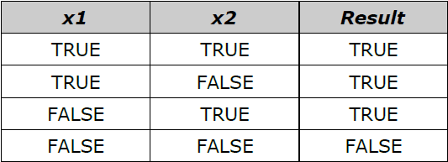
|| (logical OR) and | (boolean logical inclusive OR)
Given an expression,
exp1 || exp2
|| will evaluate the expression exp1, and immediately return a true value is exp1 is true.
If exp1 is true, the operator never evaluates exp2 because the result of the operator will be true regardless of the value of exp2.
In contrast, the | operator always evaluates both exp1 and exp2 before returning an answer

Slide 29
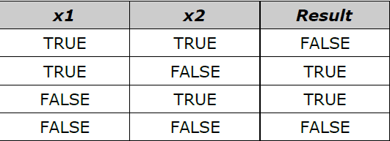
^ (boolean logical exclusive OR)
The result of an exclusive OR operation is TRUE, if and only if one operand is true and the other is false.
Note that both operands must always be evaluated in order to calculate the result of an exclusive OR

Slide 30
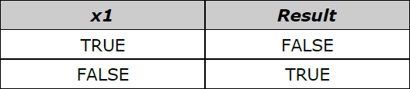
! (logical NOT)

Slide 31
Selamat Ngoding

